Slide 1
myExperience Surveys
The UNSW My Experience survey still open for 22T2, participation is highly encouraged.
“Please participate in the myExperience Survey and take the opportunity to share your constructive thoughts on your 2022 learning experience. Your contributions help your teachers and shape the future of education at UNSW.”
More information: https://www.student.unsw.edu.au/myexperience

Slide 2
Graph-Level Features and
Graph Kernels

Slide 3
Graph-level Features
Goal: We want features that characterize the structure of an entire graph.
For example:
B
F
A
D
E
G
C
H
3

Slide 4
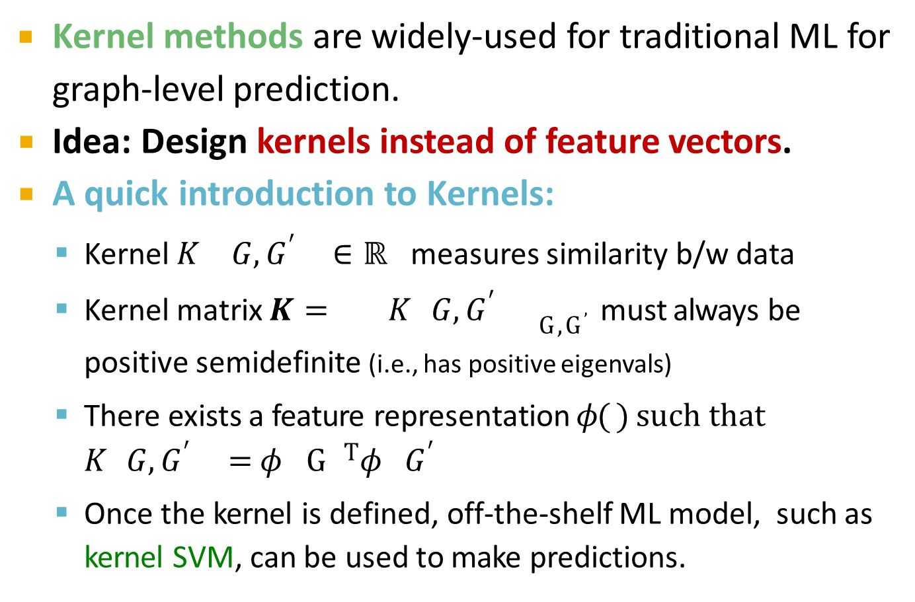
Kernel Methods
Kernel methods are widely-used for traditional ML for graph-level prediction.
Idea: Design kernels instead of feature vectors.
A quick introduction to Kernels:
Kernel 𝐾 𝐺, 𝐺$′$ ∈ ℝ measures similarity b/w data
Kernel matrix 𝑲 = 𝐾 𝐺, 𝐺$′$ _{G,G}$’$must always be positive semidefinite (i.e., has positive eigenvals)
There exists a feature representation 𝜙( ) such that
𝐾 𝐺, 𝐺$′$ = 𝜙 G ^{T}𝜙 𝐺$′$
Once the kernel is defined, off-the-shelf ML model, such as kernel SVM, can be used to make predictions.
·
4

Slide 5
Overview
Graph Kernels: Measure similarity between two graphs:
Graphlet Kernel [1]
Weisfeiler-Lehman Kernel [2]
Other kernels are also proposed in the literature
(beyond the scope of this lecture)
Random-walk kernel
Shortest-path graph kernel
And many more…
Shervashidze, Nino, et al. "Efficient graphlet kernels for large graph comparison." Artificial Intelligence and Statistics. 2009.
Shervashidze, Nino, et al. "Weisfeiler-lehman graph kernels." Journal of Machine Learning Research 12.9 (2011).
5

Slide 6
Key Idea
Goal: Design graph feature vector 𝜙 𝐺
Key idea: Bag-of-Words (BoW) for a graph
Recall: BoW simply uses the word counts as features for documents (no ordering considered).
Naïve extension to a graph: Regard nodes as words.
Since both graphs have 4 red nodes, we get the same feature vector for two different graphs…
𝜙( ) = 𝜙
6

Slide 7
Key Idea
What if we use Bag of node degrees?
Deg1: Deg2: Deg3:
𝜙( ) = count(
𝜙( ) = count(
) = [1, 2, 1]
Obtains different features for different graphs!
) = [0, 2, 2]
Both Graphlet Kernel and Weisfeiler-Lehman (WL) Kernel use Bag-of-* representation of graph, where * is more sophisticated than node degrees!
7

Slide 8
Graphlet Features
Key idea: Count the number of different graphlets in a graph.
Note: Definition of graphlets here is slightly different from node-level features.
The two differences are:
Nodes in graphlets here do not need to be connected (allows for isolated nodes)
The graphlets here are not rooted.
Examples in the next slide illustrate this.

Slide 9
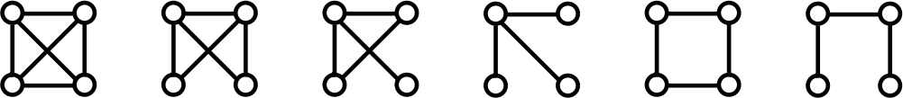
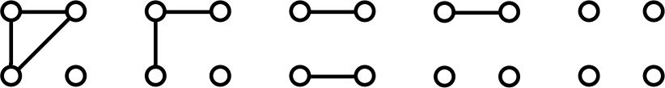
Graphlet Features
Let 𝓖_{𝒌}=(𝒈_{𝟏,} 𝒈_{𝟐}, … , 𝒈_{𝒏𝒌} ) be a list of graphlets of size 𝒌.
For 𝑘 = 3 , there are 4 graphlets.
For 𝑘 = 4 , there are 11 graphlets.
Shervashidze et al., AISTATS 2011

Slide 10
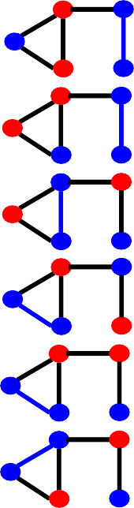


Graphlet Features
𝑔₁
𝑔₂
𝑔₃
𝑔₄
Example for 𝑘 = 3.
𝐺
𝒇_{G} = (1,
3,
6,
0)^{T}

Slide 11
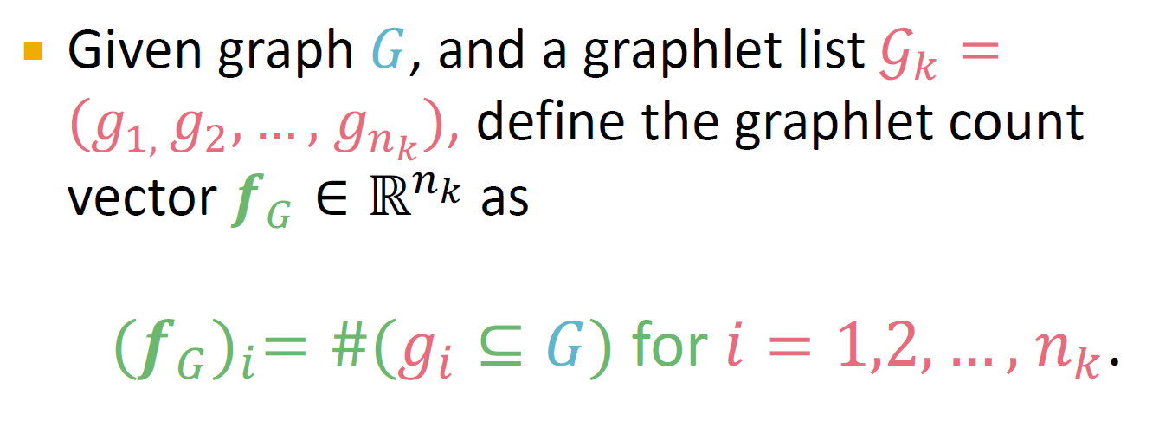
Graphlet Features

Slide 12
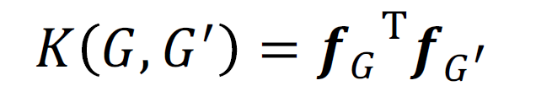
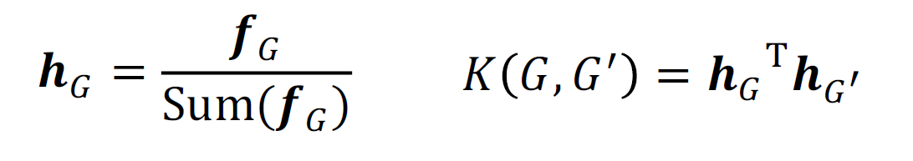
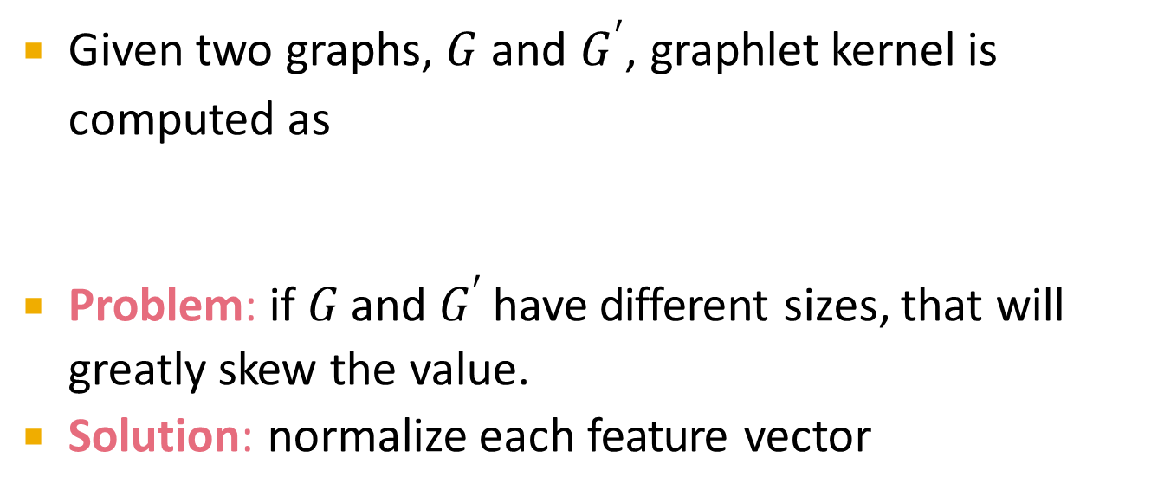
Graphlet Kernel
Given two graphs, 𝐺 and 𝐺$′$, graphlet kernel is computed as
Problem: if 𝐺 and 𝐺$′$ have different sizes, that will greatly skew the value.
Solution: normalize each feature vector

Slide 13
Graphlet Kernel
Limitations: Counting graphlets is expensive!
Counting size-𝑘 graphlets for a graph with size 𝑛
by enumeration takes 𝑛^{k}.
This is unavoidable in the worst-case since subgraph isomorphism test (judging whether a
graph is a subgraph of another graph) is NP-hard.
If a graph’s node degree is bounded by 𝑑, an
𝑂(𝑛𝑑^{k-1)}) algorithm exists to count all the graphlets of size 𝑘.

Slide 14
Weisfeiler-lehman Kernel
Goal: design an efficient graph feature descriptor 𝜙(𝐺)
Idea: use neighborhood structure to iteratively "enrich" node vocabulary.
Generalized version of Bag of node degrees since node degrees are one-hop neighborhood information.

Slide 15
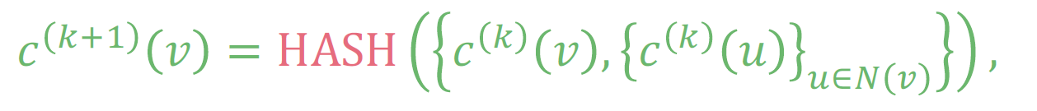
Color Refinement
Given: A graph 𝐺 with a set of nodes 𝑉.
Assign an initial color 𝑐 ⁰ 𝑣 to each node 𝑣.
Iteratively refine node colors by
where HASH maps different inputs to different colors.
After 𝐾 steps of color refinement, 𝑐 ^{K} 𝑣
summarizes the structure of 𝐾-hop neighborhood

Slide 16
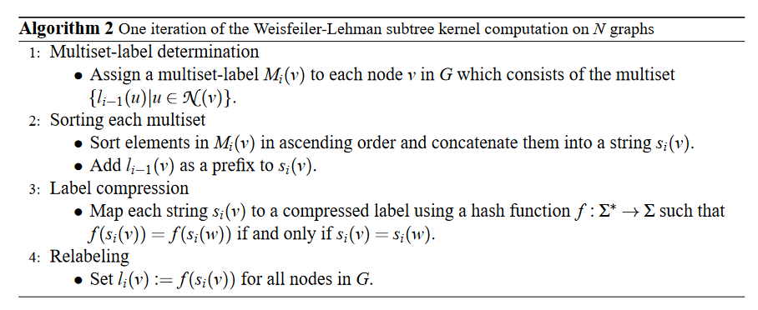
Color Refinement
Also known as the 1-dimensional Weisfeiler-Lehman Algorithm

Slide 17
Color Refinement
Example of color refinement given two graphs
Assign initial colors
1
1 1
1
1
1
1
1
1 1
Aggregate neighboring colors
1
1
1,111
1,11
1,11
1,111
1,1111
1,111
1,1111
1,111
1,1
1,1
1,1
1,1

Slide 18
Color Refinement
Example of color refinement given two graphs
Aggregated colors
1,111 1,11
1,11 1,111
1,1111
1,111
1,1111
1,111
1,1
1,1
1,1
1,1
Hash aggregated colors
Hash table
4
3
3
4
1,1 | --> | 2
1,11 | --> | 3
1,111 | --> | 4
1,1111 | --> | 5
5
4
5
4
2
2
2
2

Slide 19
Color Refinement Algorithm (1)
Example of color refinement given two graphs
Aggregated colors
4
3
3 4
5
4
5
4
2 2
Hash aggregated colors
2
2
3,45
4,345
4,345
3,44
5,2244
4,345
5,2344
4,245
2,5
2,5
2,5
2,4

Slide 20
Color Refinement Algorithm (2)
Example of color refinement given two graphs
Aggregated colors
3,45 4,345
4,345 3,44
5,2244
4,345
5,2344
4,245
2,5
2,5
2,5 2,4
Hash table
Hash aggregated colors
11
8
9
11
2,4 | --> | 6
2,5 | --> | 7
3,44 | --> | 8
3,45 | --> | 9
4,245 | --> | 10
4,345 | --> | 11
5,2244 | --> | 12
5,2344 | --> | 13
12
11
13
10
7
7
7
6

Slide 21
Weisfeiler-lehman Features
After color refinement, WL kernel counts number of nodes with a given color.
Colors 1,2,3,4,5,6,7,8,9,10,11,12,13
= [6,2,1,2,1,0,2,1,0, 0, 2, 1, 0]
Counts
𝜙(
𝜙(
)
)
1,2,3,4,5,6,7,8,9,10,11,12,13
= [6,2,1,2,1,1,1,0,1, 1, 1, 0, 1]

Slide 22
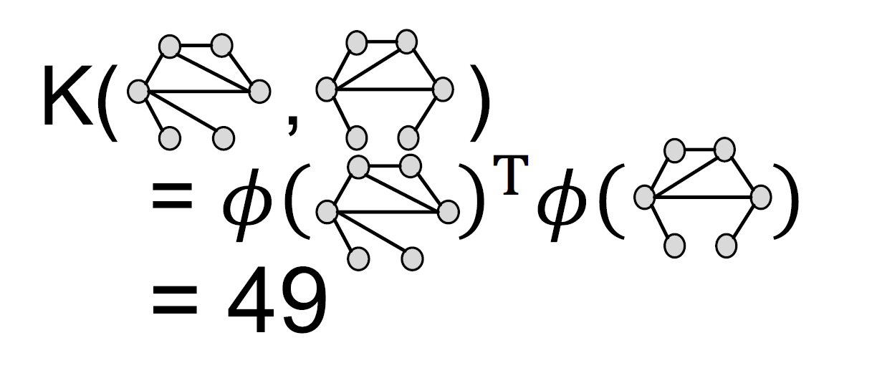

Weisfeiler-lehman Kernel
The WL kernel value is computed by the inner product of the color count vectors:
50

Slide 23
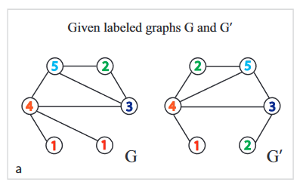
WL features on Labeled Graph (1)

Slide 24
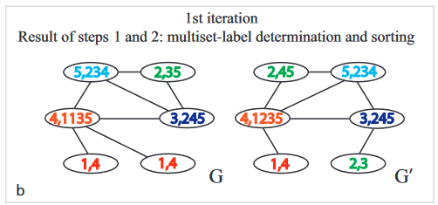
WL features on Labeled Graph (2)

Slide 25
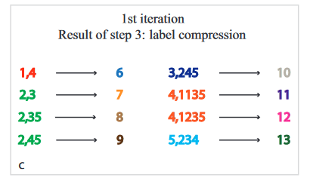
WL features on Labeled Graph (3)

Slide 26
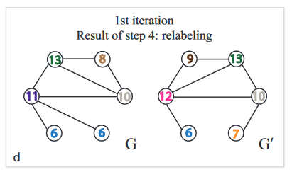
WL features on Labeled Graph (4)

Slide 27
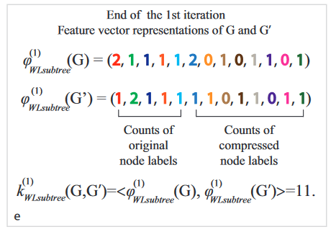
WL features on Labeled Graph (5)

Slide 28
Weisfeiler-lehman Kernel
WL kernel is computationally efficient
The time complexity for color refinement at each step is linear in #(edges), since it involves aggregating neighboring colors.
When computing a kernel value, only colors appeared in the two graphs need to be tracked.
Thus, #(colors) is at most the total number of nodes.
Counting colors takes linear-time w.r.t. #(nodes).
In total, time complexity is linear in #(edges).

Slide 29
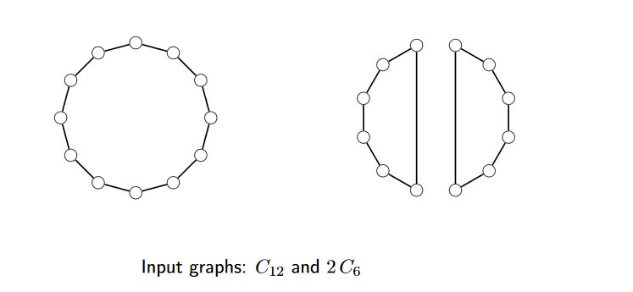
Example: a 2-dimensional Weisfeiler-lehman Algorithm
The k-dimensional Weisfeiler-Leman algorithm (k-WL), for k ≥ 2, is a generalization of the 1-WL which colors tuples from V(G)^{k} instead of nodes
From https://www.iti.zcu.cz/wl2018/pdf/wl2018_verbitsky.pdf

Slide 30
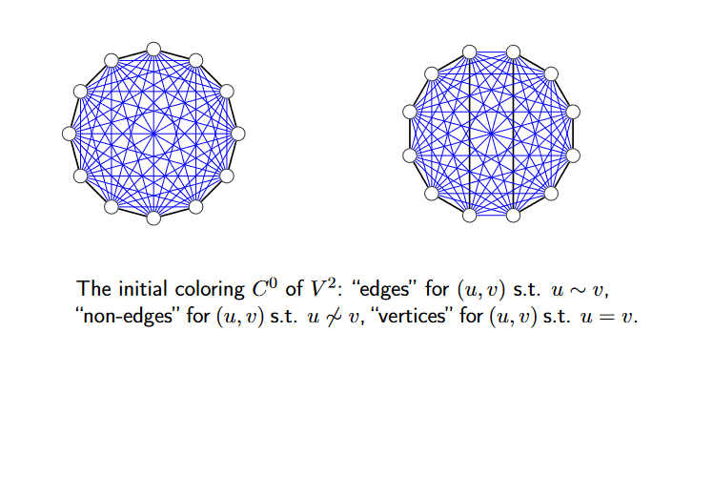
Example: a 2-dimensional Weisfeiler-lehman Algorithm

Slide 31
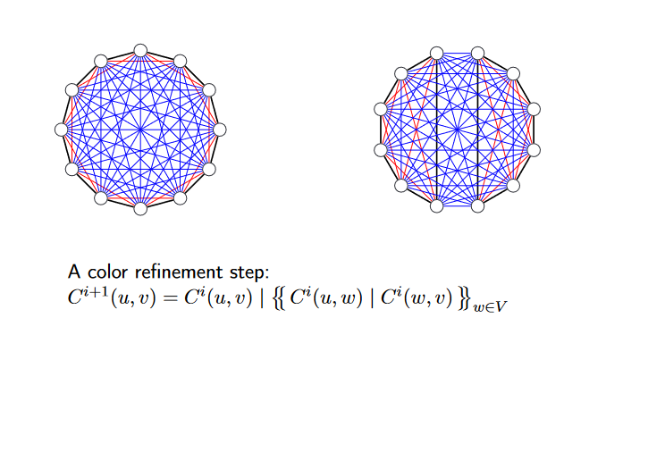
Example: a 2-dimensional Weisfeiler-lehman Algorithm

Slide 32
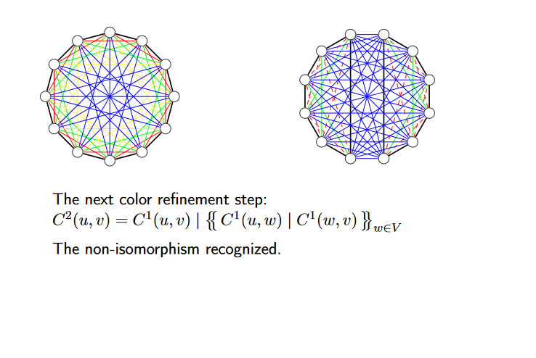
Example: a 2-dimensional Weisfeiler-lehman Algorithm

Slide 33
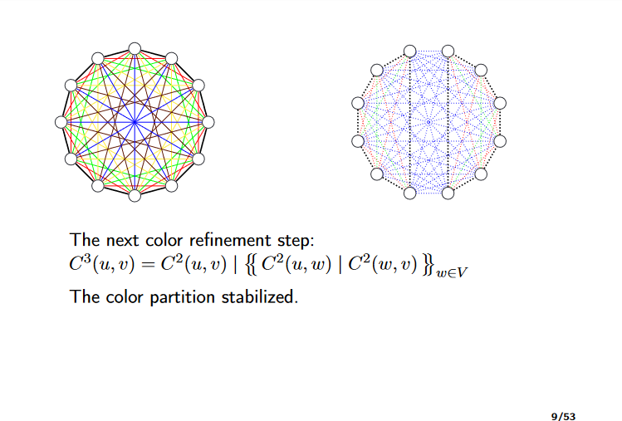
Example: a 2-dimensional Weisfeiler-lehman Algorithm

Slide 34
Graph-level Features: Summary
Graphlet Kernel
Graph is represented as Bag-of-graphlets
Computationally expensive
Weisfeiler-Lehman Kernel
Apply 𝐾-step color refinement algorithm to enrich node colors
Different colors capture different 𝐾-hop neighborhood structures
Graph is represented as Bag-of-colors
Computationally efficient
Closely related to Graph Neural Networks (as we will see!)
34

Slide 35
Learning Outcome
Traditional ML Pipeline
Hand-crafted feature + ML model
Hand-crafted features for graph data
Node-level:
Node degree, centrality, clustering coefficient, graphlets
Link-level:
Distance-based feature
local/global neighborhood overlap
Graph-level:
Graphlet kernel, WL kernel
Acknowledgement: Jure Leskovec, Stanford University

